Slide 1


Oral Communication Skills A
(CELEN069)
Lesson 11.2

Slide 2
Lesson aims and objectives
By the end of this lesson, you should have enhanced your speaking and listening ability through practice.
In addition, you should be better able to … | Intended Learning Outcomes
engage effectively in a discussion | 1.1 1.3 1.6 2.1 2.2 2.4-2.7
reflect on own learning experiences

Slide 3

Getting started

Slide 4
Getting started
Go to the class Team and look at the group discussion exam prompts posted by your classmates.
As a group (3-4 students) choose one to discuss in class today.
Notes:
Teacher example: (medical) robot

Slide 5
Discussion practice

Slide 6
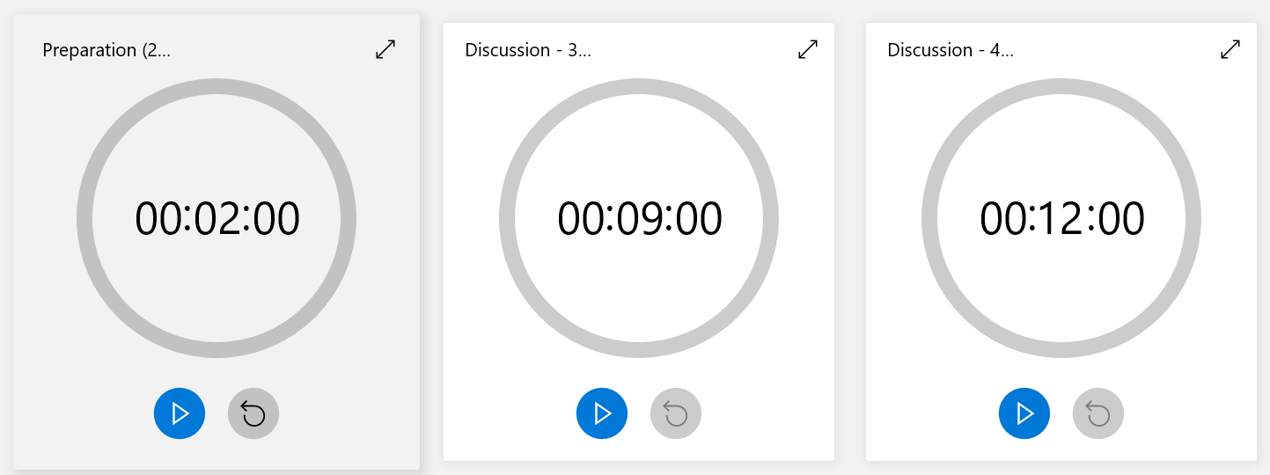
Discussion practice
You now have 2 minutes to prepare and then 9 minutes / 12 minutes to discuss the prompt you chose.
Note: In your Group Discussion Exam, if you speak to other group members during the 2 minutes preparation time, you must speak in English.
Notes:
Teacher example: (medical) robot

Slide 7
Reflection

Slide 8

Reflection
Use the Group discussion reflection checklist (from the Class Workbook, Lesson 11.2) to analyse your performance during the group discussion you’ve just finished.
Based on the checklist, what are the main areas that you could improve in your next group discussion practice? Be practical and realistic!

Slide 9

Week 12 - Mock exam

Slide 10
Week 12: Mock exam
You only need to attend at the time allocated below.
Lesson 12.1 |  | Lesson 12.2
Group 1 (3-4 students) | Group 3 (3-4 students) | Group 5 (3-4 students)
Group 2 (3-4 students) | Group 4 (3-4 students) | Group 6 (3-4 students)
Notes:
Teacher example: (medical) robot

Slide 11
Exam period: Assessed Group Discussion Exam
You will receive information from the CPSO about exam location, date and time.
You will be told to arrive at a Waiting Room at least 10 minutes before your exam time. All phones and electronic devices must be switched off before leaving the Waiting Room.
The examiner will come and collect you in a group (of 3-4 students) and take you to the Exam Room.
You should take all your things to the Exam Room as you will not be allowed back into the Waiting Room afterwards.
If you are late OR if you don’t have your student ID card with you, you will not be allowed to take the exam.
Notes:
Teacher example: (medical) robot

Slide 12
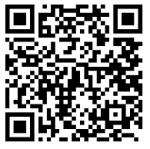
End of semester feedback
Student Evaluation of the Teacher (SET)
Teacher name: _____________
PIN number: _____________
https://bluecastle-cn-surveys.nottingham.ac.uk

Slide 13
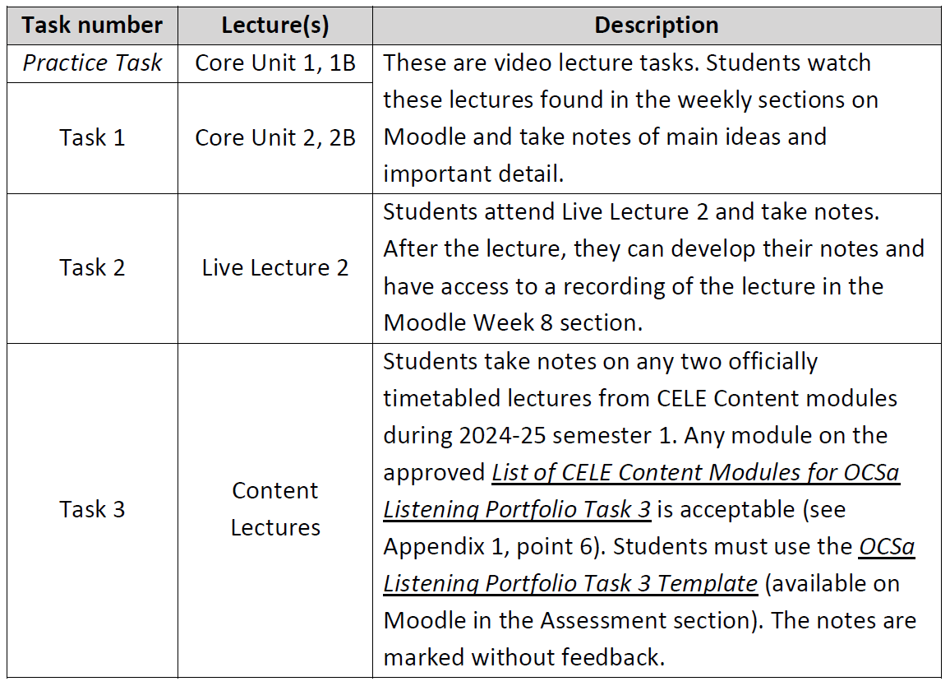
Reminder
Next week you have to submit your Listening Portfolio Task 3
by Monday 16th December 3pm to Moodle (Assessment section).

Slide 14

Homework
Due | Task
Week 12 | Review and come prepared for the Mock Exam.

